Slide 1

MCA Major Project Mid Term Evaluation
Enterprise Revenue Assurance Tool
Under the guidance of
Dr. Govind Murari Upadhyay
Department of Computer Applications
Faculty of Science, Technology and Architecture
Manipal University Jaipur
By
Akshit Arora
23FS20MCA00006
2023-25

Slide 2
Outline
About The Organization
Introduction
Motivation
Process Model
Software Requirement Specification (SRS)
Data Flow Diagram (DFD)
Outputs
Conclusion
Future Scope

Slide 3
About The Organization
KPMG International Limited, commonly referred to as KPMG, is a leading global network of professional services firms providing audit, tax, and advisory solutions. Established in 1987 from the merger of Klynveld Main Goerdeler (KMG) and Peat Marwick International, KPMG operates in over 143 countries with a workforce of more than 270,000 employees. The company is committed to serving businesses, governments, and non-profit organizations by offering innovative and customized solutions.
KPMG's mission is to inspire confidence and empower positive change. Its core values include Integrity, Excellence, Courage, Together, and For Better. These values guide the firm’s operations, ensuring they maintain transparency, ethical conduct, and client-centric services.
KPMG provides a broad range of services categorized into three key areas: audit, tax, and advisory. The firm delivers independent audit services that enhance the reliability of financial information, ensuring regulatory compliance and providing insights that help clients strengthen their financial reporting. In tax services, KPMG assists clients in managing complex tax regulations, including corporate tax, international tax planning, transfer pricing, and indirect tax solutions. Its advisory services offer expertise in management consulting, risk management, and financial advisory, helping clients optimize operations, manage risks, and achieve strategic goals.

Slide 4
Introduction
The Enterprise Revenue Assurance Tool (ERAT) is a strategic system developed to enhance the accuracy, transparency, and efficiency of revenue management within an organization. It is especially critical in industries where financial transactions are complex and high-volume, such as telecommunications, finance, or large-scale consulting. ERAT functions by continuously monitoring revenue streams, comparing recorded data with expected outcomes, and identifying discrepancies or potential revenue leakages in real time. It integrates with core business systems—like billing platforms, customer relationship management (CRM) tools, and enterprise resource planning (ERP) systems—to automatically reconcile data, reducing the risk of manual errors and missed income.
Additionally, ERAT supports compliance with accounting standards such as IFRS and internal financial policies, ensuring proper revenue recognition and audit readiness. With built-in analytics and reporting dashboards, the tool empowers finance teams and decision-makers with actionable insights, enabling them to make smarter, data-driven strategies to maximize revenue recovery, maintain financial integrity, and drive operational efficiency across the enterprise.

Slide 5
Motivation
The motivation for developing the Project Enterprise Revenue Assurance Tool (ERAT) stems from the growing need to protect and optimize revenue in increasingly complex and dynamic business environments. Many organizations face challenges such as revenue leakages, inaccurate billing, data mismatches across systems, and lack of real-time visibility into financial performance. These issues not only lead to financial losses but also pose compliance and audit risks. ERAT was initiated to address these challenges by creating a centralized, automated solution that ensures end-to-end visibility and control over revenue streams.
The project aims to improve accuracy in revenue recognition, strengthen internal financial governance, reduce dependency on manual processes, and enhance the organization's ability to respond to discrepancies quickly. By doing so, ERAT supports strategic decision-making, boosts operational efficiency, and reinforces trust in the organization’s financial data—making it a critical tool for sustaining growth and competitiveness.

Slide 6
Process Model
The process model for the Project Enterprise Revenue Assurance Tool (ERAT) in a web development context—based on frontend, backend, and Python—follows a modular, interactive, and data-driven workflow. Here's a brief yet detailed explanation:
1. Frontend (Client-Side)
Technology: React, HTML/CSS, JavaScript
Function: Provides the user interface for finance/audit users.
Key Features: Data upload (CSV/Excel)
Filters (date, region, revenue type)
Dashboards (charts, KPIs, revenue trends)
2. Backend (Server-Side using Python)
Technology: Fast API or Flask (Python web frameworks)
Function: Handles business logic, data processing, and API services.
Key Components: API Layer: Exposes REST endpoints for frontend interactions (upload, fetch reports).
3. Database Layer
Technology: PostgreSQL
Function: Stores all data securely.
Data Stored: Uploaded raw data.
Processed revenue entries.

Slide 7
Software Requirement Specification (SRS)
Software Requirement:
I. HTML (Hyper Text Markup Language): HTML is the standard language for creating and structuring web pages. It defines elements like headings, paragraphs, links, images, and forms to build the foundation of a website.
II. CSS (Cascading Style Sheets): CSS is used for styling HTML content, controlling Layout , colors, fonts, and design. It enhances the appearance of web pages, making them more visually appealing and responsive.
III. JavaScript: JavaScript is a versatile programming language used for adding interactive features to web applications. It enables dynamic content, animations, and user interactions.
IV. React: React is a JavaScript library for building user interfaces, primarily for singlepage applications. It uses a component-based architecture, making UI development faster and more efficient.
V. Python: Python is a high-level, interpreted programming language known for its simplicity and versatility. It is widely used in web development, data analysis, AI, and machine learning applications.
VI. TensorFlow: TensorFlow is an open-source machine learning framework developed by Google. It provides tools for building and training deep learning models, including neural networks.
VII. Pytesseract: Pytesseract is a Python wrapper for Google’s Tesseract-OCR engine. It is used for Optical Character Recognition (OCR) to extract text from images.
VIII. Tkinter: Tkinter is a Python library for creating desktop applications with graphical user interfaces (GUIs). It provides widgets like buttons, labels, and text boxes.

Slide 8
Software Requirement Specification (SRS) Cont.
Software Requirement:
IX. Scikit-Learn: Scikit-Learn is a Python library for machine learning. It offers simple and efficient tools for data mining, analysis, and modeling using classification, regression, and clustering algorithms.
X. Streamlit: Streamlit is an open-source Python library for building interactive web applications for data science and machine learning projects. It simplifies the process of visualizing and sharing models.
XI. Flask: Flask is a lightweight Python web framework used to build web applications and REST APIs. It is known for its simplicity, flexibility, and ease of integration with other libraries.
Hardware Requirement:
I. Processor: Intel i5 or higher
II. RAM: 8GB or above
III. Storage: 500GB SSD or higher
IV. GPU: NVIDIA GeForce GTX 1050 or higher (for AI operations)

Slide 9
Data Flow Diagram (DFD)
Order to Billing System Reconciliation
Contracts
CRM System
Billing Systems
Customer Bill
Contract to CRM System
Order to Network System Reconciliation
Network / Provisioning
Asset Database
Asset Reconciliation
Network to Bill Usage and Services Reconciliation

Slide 10
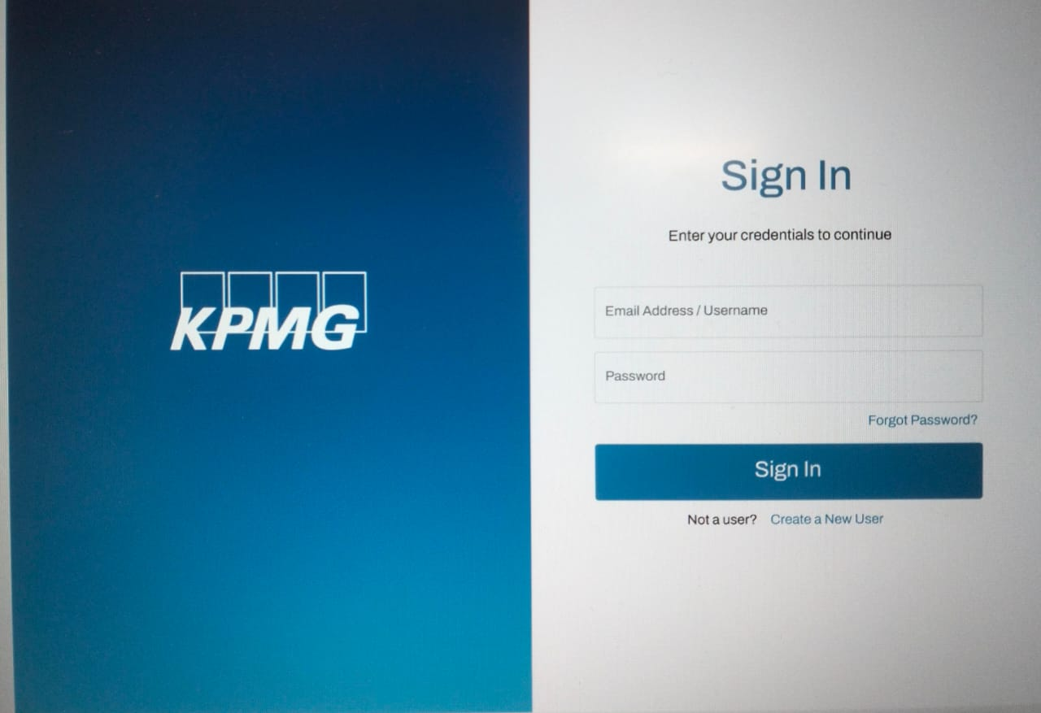
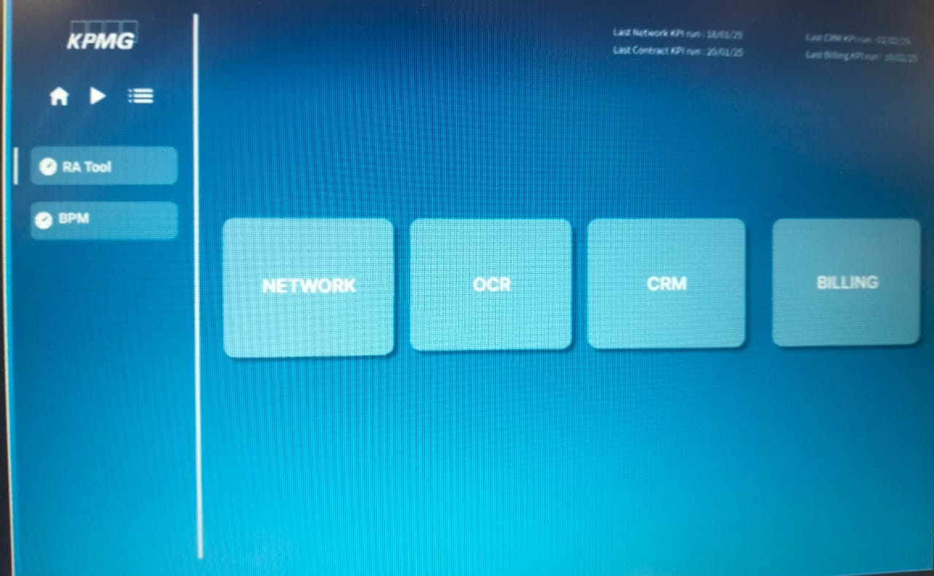
Outputs
Sign In Page
Home Page

Slide 11
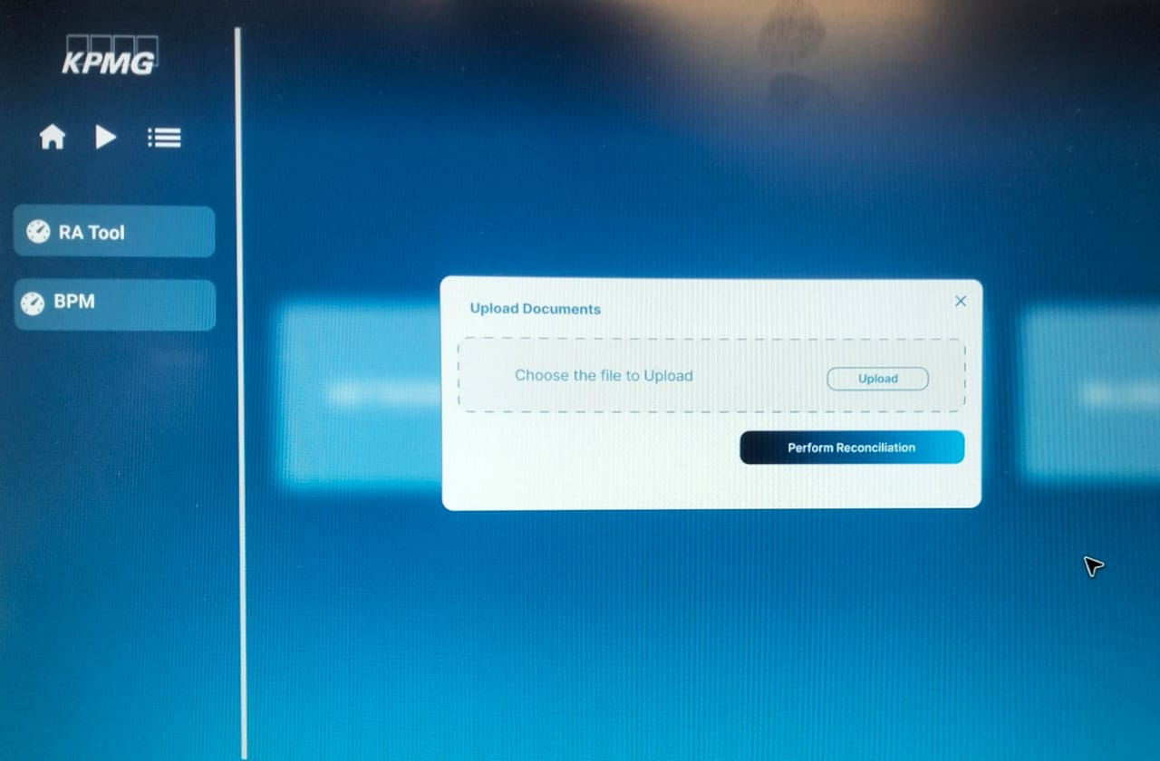
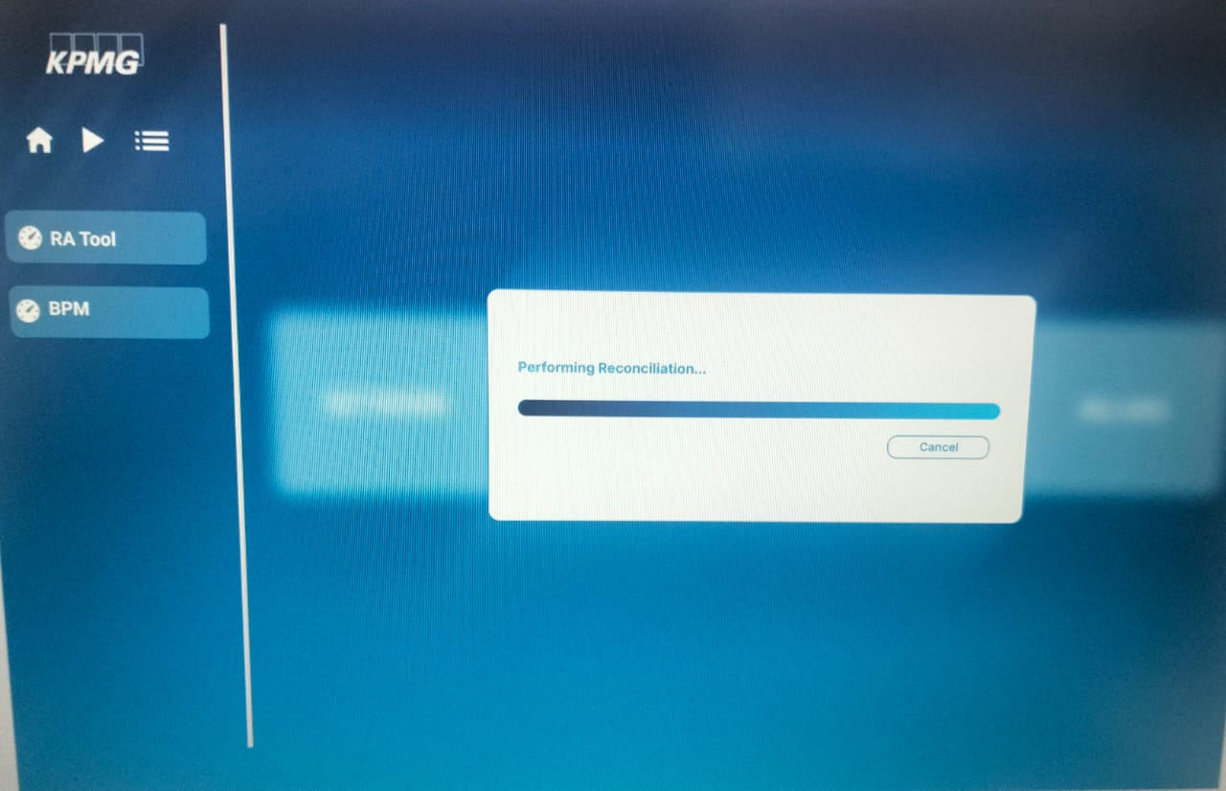
Outputs
File choose Page
File Upload Page

Slide 12
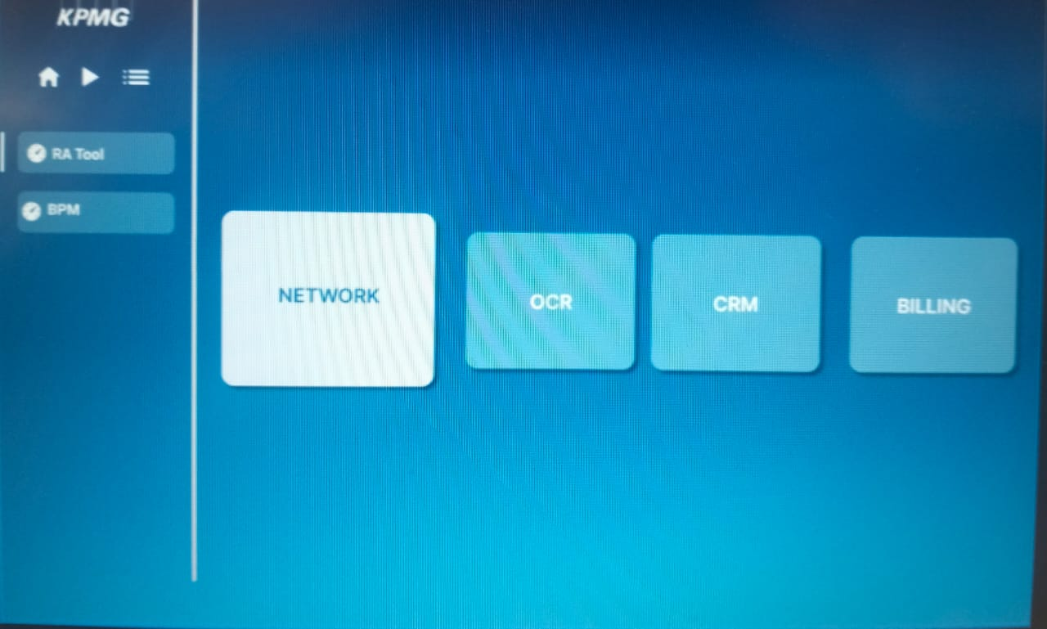
Outputs
Dashboard Page

Slide 13
Conclusion
The Project Enterprise Revenue Assurance Tool (ERAT) represents a strategic advancement in how organizations manage, monitor, and secure their revenue streams. By combining an intuitive frontend with a robust Python-powered backend, ERAT automates complex tasks such as data validation, reconciliation, and exception handling across various financial systems. It ensures end-to-end visibility, enhances compliance, and minimizes revenue leakages through real-time insights and streamlined workflows. ERAT not only empowers finance and audit teams with accurate and actionable data but also strengthens governance, reduces manual errors, and supports smarter, data-driven decision-making. In today’s data-centric and compliance-focused environment, ERAT stands as a critical tool for achieving financial transparency, operational efficiency, and long-term revenue assurance.

Slide 14
Future Scope
The Project Enterprise Revenue Assurance Tool (ERAT) holds significant potential for future development and expansion. As organizations increasingly adopt digital transformation and handle larger volumes of financial data, ERAT can evolve to include AI and machine learning capabilities for predictive analytics, trend forecasting, and intelligent anomaly detection—allowing it to proactively identify risks before they impact revenue. The tool can also be enhanced with real-time data processing using technologies like Kafka or Spark, enabling immediate reconciliation and faster decision-making.
In terms of scalability, ERAT can be transitioned to a cloud-native architecture, offering multi-tenant support for large enterprises with global operations. Deeper integration with enterprise ecosystems such as SAP, Oracle Financials, and Salesforce would allow seamless data flow and expand its use across departments. The user experience can also be elevated with mobile-friendly dashboards, customizable reports, and role-based views for different stakeholders (e.g., CFOs, auditors, analysts).

Slide 15
